Slide 1
Updates: - PSH Centralized Housing Registry - ID Taskforce
Oakland County Alliance for Housing
Debra Hendren, Community Housing Network

Slide 2
PSH - Initial Conversations
KEY DIFFERENCES
TRACKING
DEFINITIONS
INTAKE
ELIGIBILITY
First Meeting July 2013
Notes:
Debra
THIS IS A PHASE IN SLIDE, MULTIPLE CLICKS TO GO THROUGH THE KEY FUNCTIONS WHICH ARE IN “Findings”
This meeting took a lot of planning. . .
Get the group together, various partners that had not always worked together collaboratively, especially when it came to PSH
First meeting, a lot of staring at each other – looking back it’s a completely different group and dynamic now
Develop a comfortable environment, met outside of anyone’s office
Meeting at a local Panera. . . Allowed for everyone to get a bite to eat or a cup of coffee.
Continued to meet offsite until we got to the point where we were going to start talking about confidential information. This was limited to processes.
Findings:
Each agency / organization had a different way to track those interested in accessing their program
Lots of discussion of what the definition of a “waitlist” was, vs. a “register” or another tool
Every agency also had a different method to fill empty slots and a different application process
In examining programs, there were also slightly different eligibility requirements that could be used strategically if we came together as a community

Slide 3
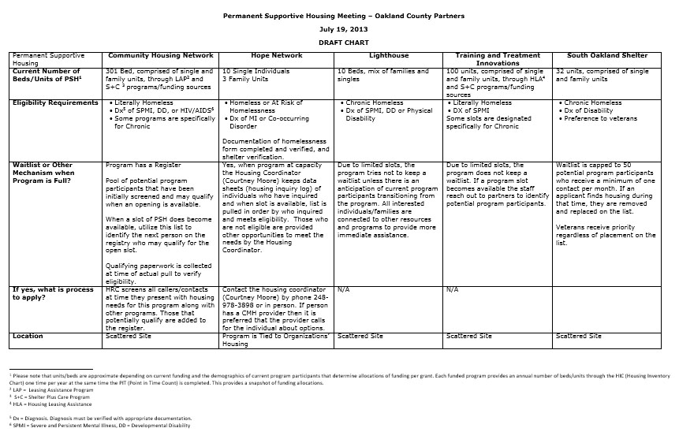
Notes:
Debra
“After these initial conversations, we tried our best to get our heads wrapped around our differences; we went ahead and created this hand-dandy chart to help with that”
- For communities with a large number of PSH agencies, this may help immensely with IDENTIFYING the NEED for prioritization in your community
**Make this also into a handout

Slide 4
The Stories of Stan and Myrna….
Stan
Myrna
STILL WAITING
Stan is homeless and has been for over a year. He called Agency 1 a year ago and is still waiting to be called back. He continues to try to access services and is put on multiple waitlists and registers but…..
LUCK OF THE DRAW!!!!
Myrna became homeless a couple of weeks ago. She happens to call an organization that just happens to have a vacancy because someone exited the program last week. Because she meets the eligibility standards, she can easily transition into the program without a long wait.
Two very different experiences……………..
Notes:
Dan
MULTIPLE CLICKS ON THE SLIDE TO GO OVER THIS
Does this look familiar at all to anyone?
This was the structure of our community before and when we began talking in 2013!
This did not even consider additional factors such as prioritization with VI scores or chronicity, as well as preference that are incorporated in some of the local grants

Slide 5
The Need….
Stan and Myrna’s situation was unfortunately common in our community
Each agency's individual registry/wait-list played into this
Need for a consistent and equitable means to access permanent supportive housing:
Centralized Permanent Supportive Housing Registry
Notes:
Dan
PHASE SLIDE SECOND CLICK
From the first meeting it was very apparent that there was a need for a new system

Slide 6
Guidance from HUD
Notice released July 2014
Goal to ensure those with most need prioritized
COC “strongly encouraged to adopt”
Establishment of a “single prioritized waiting list for PSH”
Notes:
Dan
In July 2014, during this process HUD released a notice to COC’s detailing how they would like communities to prioritize persons experiencing chronic homelessness in PSH
The timing of this notice could not have been any better; it basically affirmed all the work we’d been doing thus far and gave the group comfort in knowing we were doing what HUD wanted us to do
CPD-14-012 (July 28th 2014)

Slide 7
Guidance from HUD
Themes from the Notice:
Utilizing the SPDAT
Order of Prioritization
Dedicate beds
Documenting homelessness
How HUD
Prefers Prioritization
Longest History and Most need
All other chronic homeless
Longest History
Most severe service needs
Notes:
Dan
Notice calls for determining the severity of service needs through utilizing the SPDAT or other tools including the VI.
Recommends communities utilize coordinated assessment system to achieve this
Recommends communities dedicate and prioritize PSH beds chronic
Four groups for prioritization (don’t give too much detail from notice; just a little!)

Slide 8
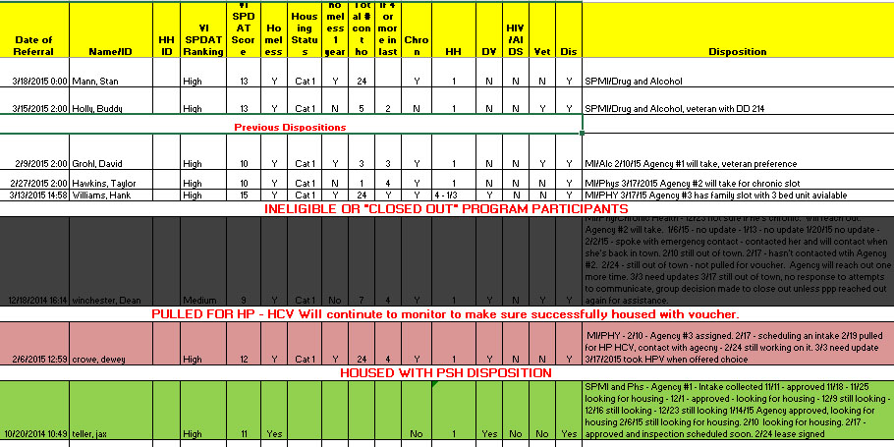
PSH Centralized Housing Registry
Disposition Report -SAMPLE
Notes:
Debra
Review data on the report, can use to make some parallels and discuss the following
Myrna and Stan are back, if both were examined same day, Stan would have “trumped” Myrna
A vet would receive preference over someone else in some programs
Chronicity also factors in especially when there is a slot reserved for chronics
Documentation for all of these fields are verified by the agency upon intake once assigned
Sometimes people who are on the registry, fall off
Choice for vouchers. . .

Slide 9
Outcomes:
As of May 1, 2015
34 program participants housed in OC PSH Programs
49 potential program participants have currently been slated for HP - HCV instead of PSH
103 potential program participants were deemed “ineligible” or “deactivated”
11 potential program participants waiting for disposition
17 potential program participants currently going through the PSH process after assignment to a PSH provider
Notes:
49 potential program participants have currently been slated for HPV instead of PSH (I would note that the number was higher but these are the ones that “chose” the voucher over PSH and are still in the process, others may have attempted this route and either decided to continue with PSH or found out they could not access the voucher)

Slide 10
ID TASKFORCE
Updates
MOU in the works between MSHDA, MCAH and SoS
SoS Exception Staff will have access to LIMITED HMIS
Pilot Program will be implemented to “fast track” packets to the Exceptions Unit for “pre-approval”. Documents are developed including a specific release of information and letter (templates).
System in place for organizations to send a monthly payment in for ID fees.

Slide 11
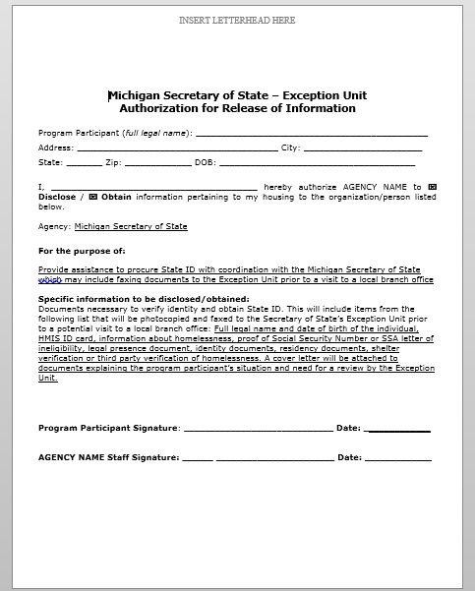
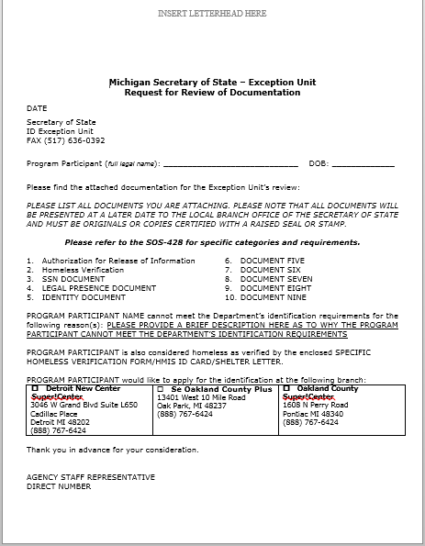
Sample Documents Community Templates - Pilot Program Implementation
Notes:
SOS Workflow is still in draft. HMSI Release language also being developed – OC plans on having it a separate document than embedded in the current HMIS ROI.

