Slide 1
Affordable Housing:
Dispelling the Myth

Slide 2

The Pipeton Family
Judy is a Medical Assistant, 35 hours a week making $12.00 an hour.
Joe is as an Emergency Medical Technician, 40 hours a week and makes $13.00 an hour.
Two children Michael (11) and Samantha (9).
Judy is Samantha’s girl scout troop leader and Joe is the assistant coach for Michaels’s soccer team.
They want to live in a community where they can feel like they can make a contribution and have a safe and welcoming place to raise their children.
This family needs affordable housing!
Notes:
Notes

Slide 3
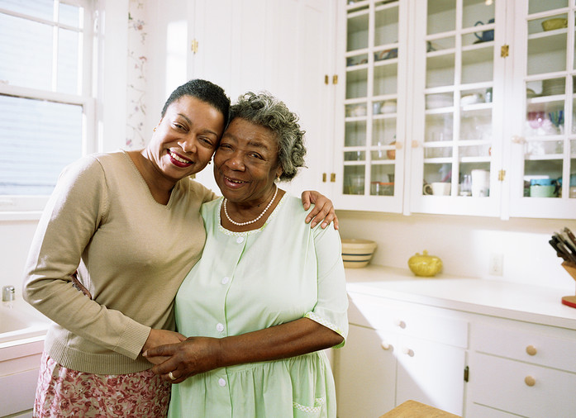
Jessica and Helen Crafter
Jessica Crafter is taking care of her mother, Helen Crafter full time and is unable to work a separate job.
Helen has had difficulty in maintaining her independence due to deteriorating health.
With Jessica currently being single and her children grown, her siblings and her decided it made the most sense for her to move in with her mother. Jessica is recently retired
However, even with both of their retirement income and help from other family members they still find it a struggle to pay for mounting medical costs while paying for all the costs associated with living in their home.

Slide 4
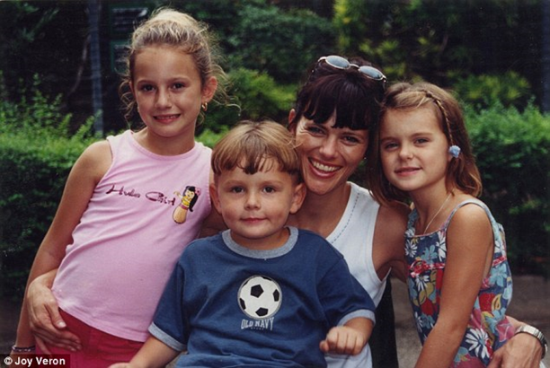
The Salvador Family
Dana (34), Jocelyn (10), Alyssa (7), Daniel (4)
Dana works two jobs, she works as a home health care aid 30 hours a week, $12 an hour and as a cashier at a grocery store 20 hours a week at $14 an hour
Even working two jobs and taking care of three children, Dana is one who neighbors turn to, to watch their children and pets or if they need a ride in an emergency

Slide 5
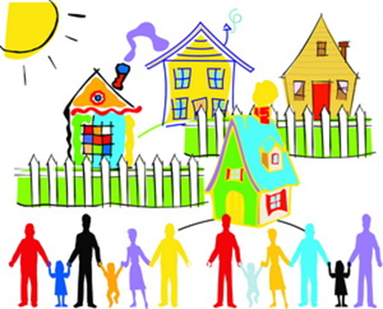
What is Affordable Housing:
Affordable housing is housing, rental or owner-occupied, that is affordable no matter what one's income is. The U.S. government regards housing costs at or below 30% of one's income to be affordable.
A wide variety of physical structures
Housing that meets residents budgetary and lifestyle needs.
Is for all members of the community in all stages of their lives
The creation of safe and successful housing in order to create safe and successful communities
Notes:
Workers providing essential services within the community are able to afford to live in the community. This helps employers attract and maintain employees, while helping alleviate transportation concerns (which are often major concerns for those employing low to moderate income service workers). The community also gains by creating a place where many different types of people can work, live and play, creating a sense of ownership in the community by workers and residents.
Housing stock is maintained and people take pride in their community. Residents, whether owners or renters are better able to afford proper maintenance and improvements to their housing due to less resources being expended on direct housing costs.

Slide 6
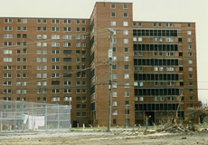
When you think of Affordable Housing do you think of this?

Slide 7
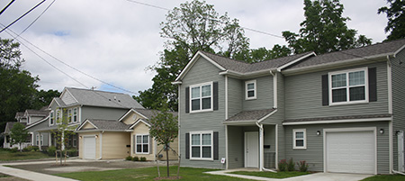
Or this?

Slide 8
Affordable Housing Is Not:
“The Projects”
Low quality
Only for those who don’t work
A handout
Unsafe or Crime Ridden
Notes:
Housing that is affordable to low and moderate income citizens of every community
Who can benefit? May include people with disabilities, homeless, people who have suffered from domestic violence, working families, students, single parents

Slide 9
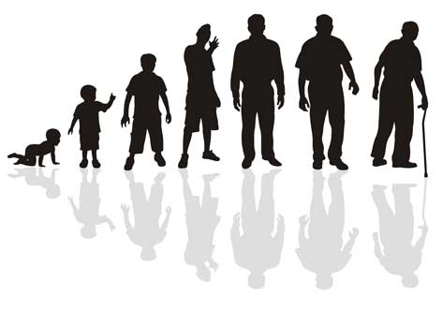
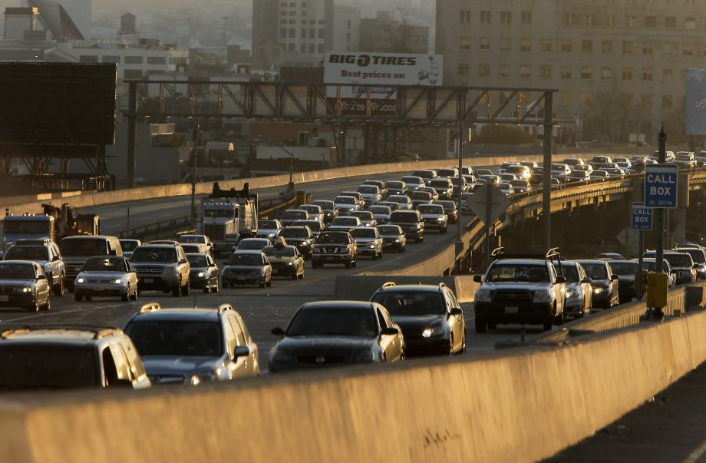
Lack of Affordable Housing Results in:
Local businesses unable to attract or retain workers
Increased transportation costs and decreased transportation reliability
Community residents segregated by different stages in their life
Crowding of multiple families or individuals within single family homes
Notes:
When a community doesn’t value the idea of affordable housing and the creation of an inclusive community where people at all stages of their life can find a home that fits both their budget and lifestyle.
By not adequately planning, the demand for housing on the lower end of the income scale is met through:
Poorly maintained, privately owned rental properties, crowding of multiple families or individuals within single family homes (often illegally or not registered) and people spending a much greater percentage of income on their basic housing needs than is considered remotely acceptable.
Money and effort that could be spent on things such as basic upkeep like painting, updating roofing, landscaping or snow removal is instead spent on direct housing costs. Housing slowly deteriorates as either owner occupiers or renters are unable to spend resources on proper maintenance.

Slide 10
Lack of Affordable Housing Results in:
62% of distressed* owners and 3 in 4 distressed* renters (74%) have made at least one of these tradeoffs in the past three years:
  27% have stopped saving for retirement
  23% have cut back on health care
  23% have accumulated credit card debt
2014 report on Hunger and Homelessness by the United States Conference of Mayors shows that 48% of the cities experienced an increase in homelessness. It identifies a lack of affordable housing as the leading cause of homelessness among families with children.
*Paying more than 30% of income towards housing costs
Notes:
Local businesses suffer as they are unable to attract or retain workers due to the lack of available affordable housing in the community. Many service workers who help make the community run on a day to day basis are not only unable to live in the community, but must commute long distances increasing transportation costs and decreasing transportation reliability.
People become segregated by different stages in their life. If young adults who grew up in a community don’t want to live with family, they must leave the community, breaking social ties and community fabric. Retirees are forced to relocate away from family and friend support structures due to lack of affordable housing.

Slide 11
Concerned about Property Values?
New affordable housing tends to have a positive to no effect on the property values of the surrounding neighborhood.*
Qualities that tend to ensure a positive effect include*:
  quality of the physical project
  quality of the property management,
  if the development is part of a larger revitalization strategy
  if it is a rehabilitation / reuse of a building
* From The Center for Housing Policy’s “ ‘Don't Put it Here!’ Does Affordable Housing Cause Nearby Property Values to Decline?”

Slide 12
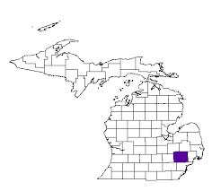
Affordable Housing Gap
 | State of Michigan | Oakland County
Minimum Wage | $8.15 | $8.15
2-Bedroom Housing Wage* | $15.16 | $16.27
Fair Market Rent Two Bedroom | $788 | $846
Rent Affordable at Mean Renter Wage | $644 | $789
Hours it would take on minimum wage to afford 2-Bedroom Housing | 74 | 80
* Wage required to affordably rent 2 bedroom apartment working 40 hours a week
*National Low Income Housing Study based on Census Data
Notes:
There are even programs for people who earn up to 80% area medium income (AMI) in Oakland County
1 person family- $36,050.00
2 person family- $41,200.00
3 person family -$46,350.00
4 person family- $51,500.00
5 person family-$55,650.00
6 person family- $59,750.00

Slide 13
Gap in Supply of Affordable Housing versus Demand

Slide 14
Economic Benefits of Housing Tax Credits
State of Michigan
United States of America
* Since the beginning of the LIHTC
Notes:
Municipalities, by law do not have to pay for affordable housing, your taxes will not go up with housing production.
Developers do not pay for the cost between the affordable and market -rate either.
The Low Income Housing Tax Credit, municipal incentives like higher density market-rate housing and several other programs assist in financing construction.

Slide 15
Be an Affordable Housing Development Ready Community!
Ensure zoning and building ordinances are affordable housing friendly
Ensure Master Plan is inclusionary for all members of the community
Be prepared to work with partner organizations to develop the most successful and sustainable affordable housing that fits with the community’s vision
Acknowledge that proper planning and inclusion of affordable housing leads to more vibrant and prosperous communities
Advocate for funding for affordable housing programs at the state and Federal levels.

Slide 16
Organizations involved in affordable housing:
HAVEN
Lighthouse of Oakland County
Oakland Livingston Human Services Agency
South Oakland Shelter
MI State Housing Development Authority
Community Housing Network
And many more!

Slide 17
Affordable Housing is Needed in your Community
The Alliance for Housing can Help!
Check out http://oaklandhomeless.org/ for more information

